Slide 1
Master-Thesis Methodical Approach for Analyzing Process Parameters and Optimizing Boundary Conditions in Multi-Axis Robot Programs
Status Update: Week 12
18.12.2023 – 24.12.2023
Jan Nalivaika

Slide 2
Progress
Exposé Done == DONE ☺
All Comments implemented == DONE ☺
Abbreviations == DONE ☺
Rundung in „Direction Changes“ analysieren == DONE ☺

Slide 3
G - Commands
G60 = the points are reached exactly, but the feedrate is reducing to 0 at every waypoint
G641 = Bahnsteuerbetrieb mit Überschleifen nach Wegkriterium (ADIS=0.5)
GLOBALE BEFEHLE:
G601:
Befehl zum Aktivieren von Genauhalt-Kriterium "Genauhalt fein"
G602:
Befehl zum Aktivieren von Genauhalt-Kriterium "Genauhalt grob"

Slide 4
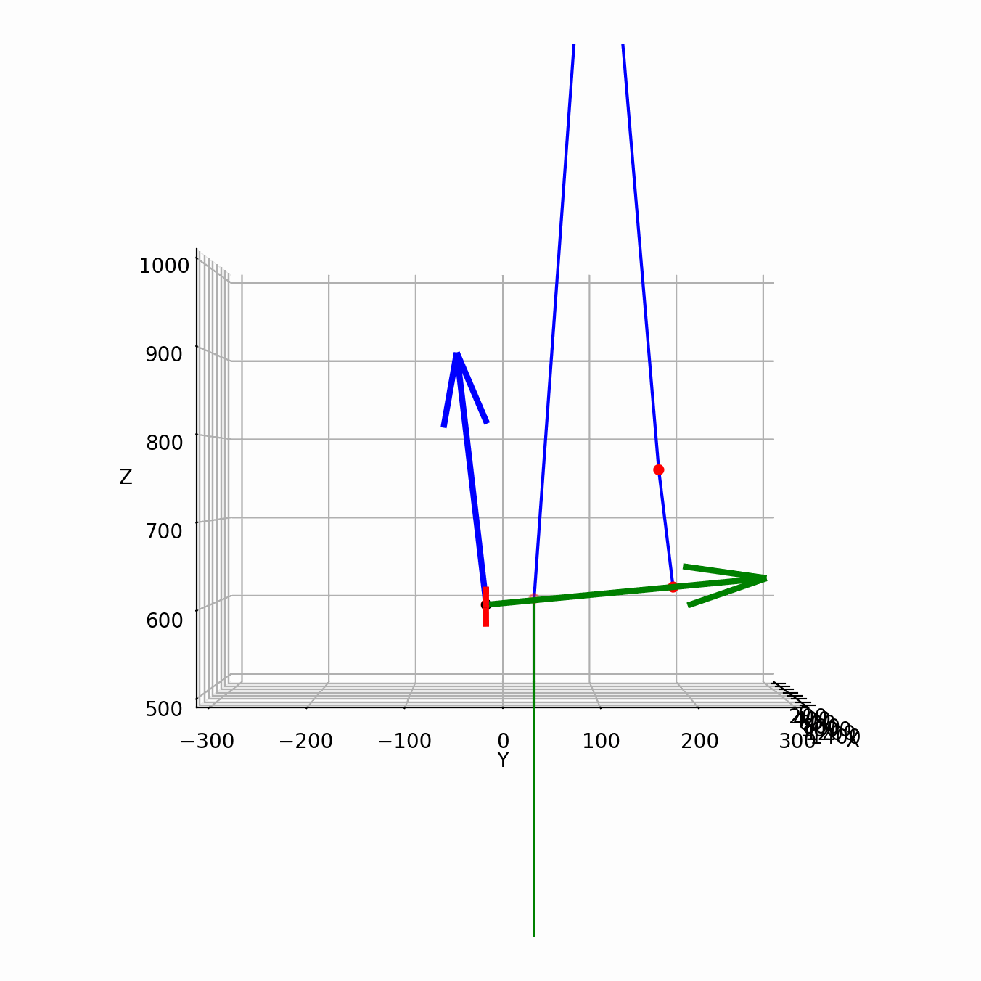
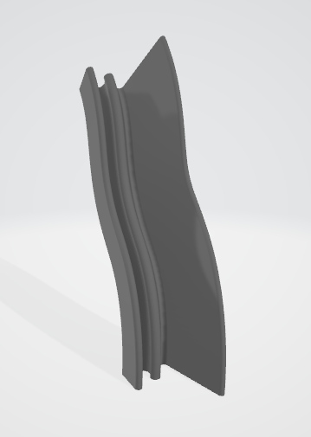
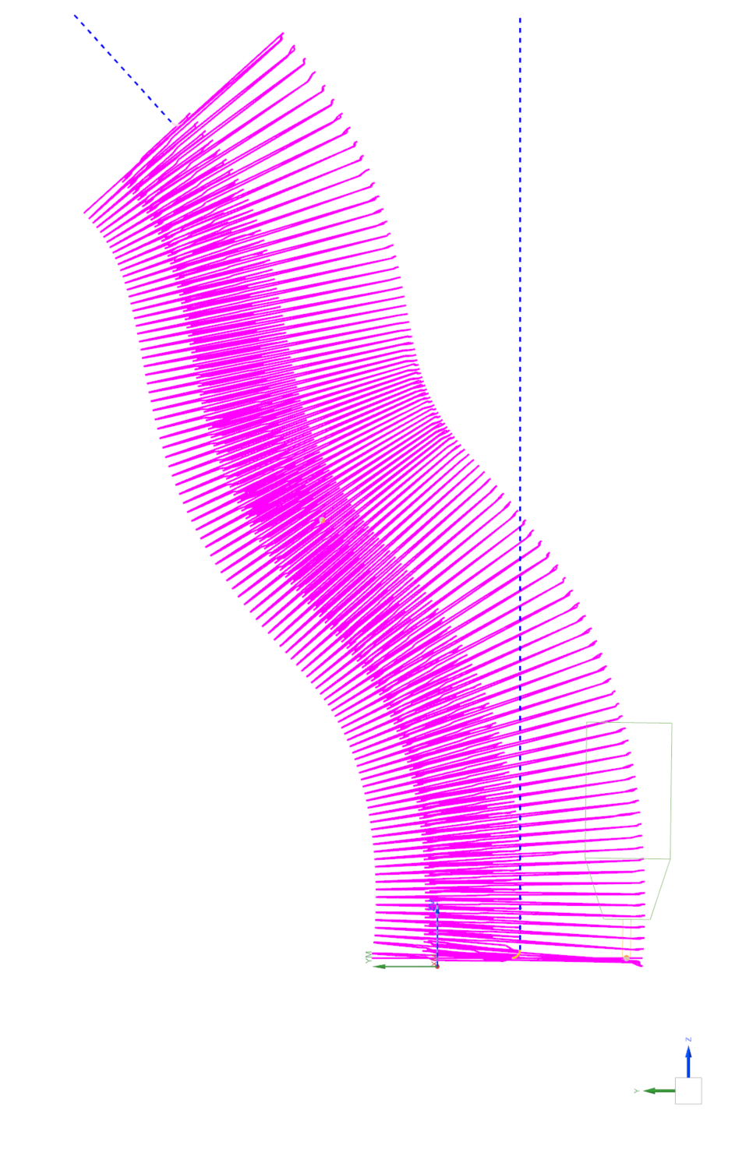
Real Gcode
Show GIF of robot with moving base
Show STL in viewer

Slide 5
Result

Slide 6
Global Score

Slide 7
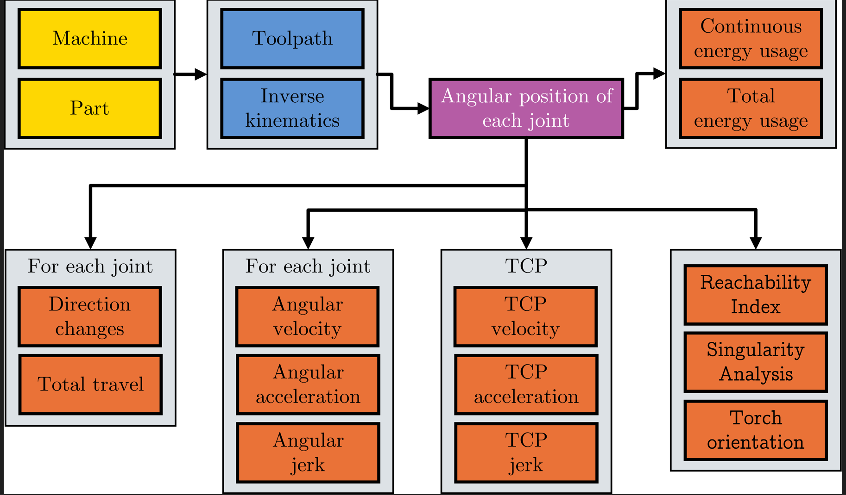
Images

Slide 8
2 Weeks to Finish
Current Status: 1+2+3 = Done
Finalize Chapter 4
Real Gcode – Write Validation
Summery – Write
Finalize Chapter 5
Conclusion – Write
Outlook – Write
Abstract – Write
Formatting
What could be done:
Real DH parameters
TCP transformation
Rotery-Tilt table adaption
Add 3rd DOF (rotation)
Bigger Gcodes

Slide 9
Contact
Jan Nalivaika (TUM) Student Otto-Hahn-Ring 6
81739 Munich, Germany
Phone +49 163 7180148
E-mail jan.nalivaika.ext@siemens.com nalivaika@outlook.de
Marius Breuer (Siemens AG)
Supervisor Otto-Hahn-Ring 6
81739 Munich, Germany
Phone +49 (172) 8396287
E-mail marius.breuer@siemens.com
Ludwig Siebert (TUM-IBW)
Supervisor Boltzmannstr. 15
85748 Garching at Munich
Phone +49 (89) 289 – 15578
E-mail ludwig.siebert@iwb.tum.de

Slide 10
Christmas planning
DATE: Ludwig Marius Jan
08.12 ☺
15.12 ☺
22.12 ☺
29.12 X ☺
05.01 ☺
12.01 ☺
19.01 X
26.01 X
02.02 ☺

Slide 11
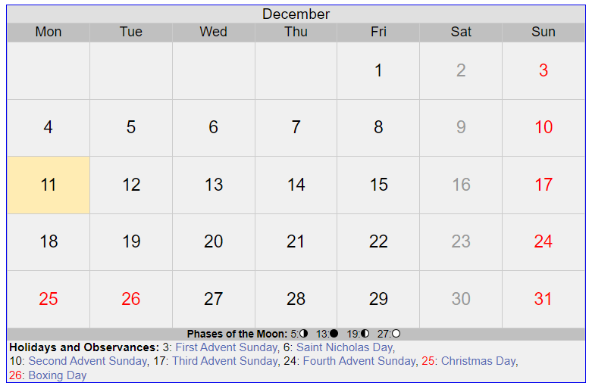
5 Tage
Dezember

Slide 12
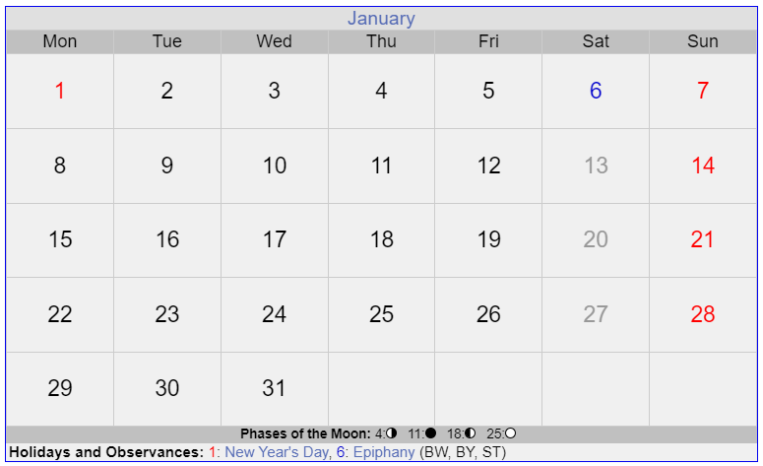
11 Tage
Januar

Slide 13
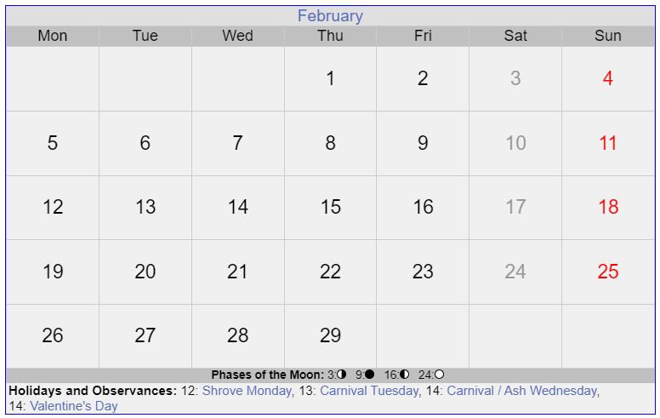
Final PDF
Paper
Paper
12 Tage
Januar

Slide 14
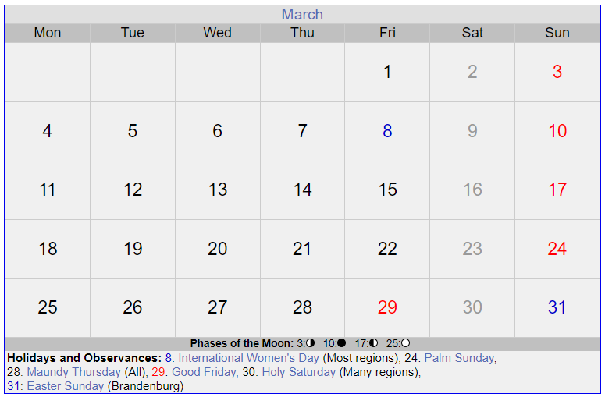
Paper
Paper
Verteidigung
PowerPoint für Verteidigung

